Slide 1
Creating supportive conditions for adolescent health
Laura Myers, Socio-behavioural Scientist
Desmond Tutu HIV Foundation, Cape Town
(no conflicts of interest to disclose)

Slide 2
Outline
SRH service barriers
Lessons learned from the Girl Power study
Adolescent and Youth-Friendly Services in the Klipfontein-Mitchell’s Plain sub-district
Tutu Teen Truck and Tutu Tester
Vital Voices: A Virtual Reality film series

Slide 3
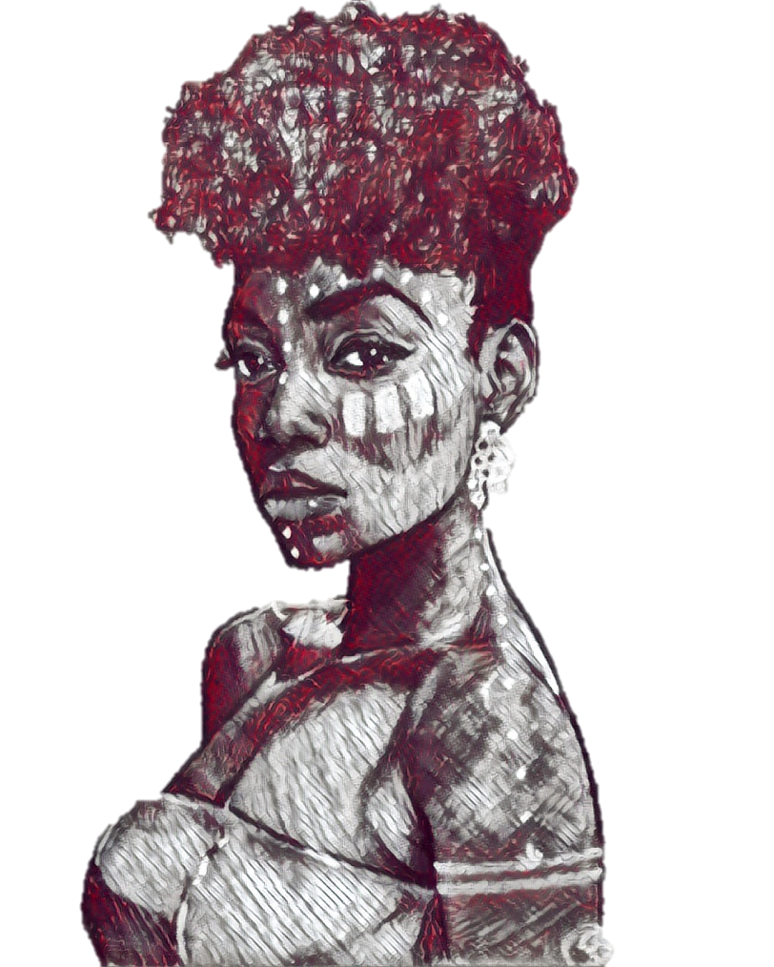
Background
Adolescence is a period of developmental transition
High rates of HIV infection, morbidity and mortality among South African adolescents
Health-seeking behaviour among adolescents and young people is sub-optimal
Low rates of HIV testing, prevention and treatment
Linkage to HIV care is poor
Multiple barriers to access

Slide 4
Girl Power study
Quasi-experimental prospective cohort study (Lilongwe and Cape Town)
Each clinic received a different model of care:
Standard of care
Combination package of care
Combo package + empowerment sessions
Combo package + empowerment + monthly cash transfers
250 young women (15-24 yrs) enrolled per clinic, followed 12 months
Data extracted from medical records to measure service uptake
60 qualitative interviews

Slide 5
Reported SRH service barriers
Limited facility hours, long waiting times
Being refused services (e.g. pregnancy tests, implant removal)
Concerns about confidentiality; shame and fear of being seen by others
Harsh treatment by healthcare workers
‘Girls in my age group… stay at home with STIs because they don’t want to be shouted at’
‘As black people we do not like complaining, because we are scared that we will be refused services, and that kills us…’
‘Every time I go there she would have an excuse, so I stopped. I didn’t go to another clinic, because I got demotivated…’
‘These people are not caring and they are not ashamed about that…’
‘They would shout that they are taking their tea time and when they come back, they would still not help you and take lunch before helping you. So, you end up feeling like not coming back…’
‘The nurses are not kind…’

Slide 6
What young women want:
Young people do not want to wait long to be seen
Young women want tailored information and integrated services
Young women want trustworthy healthcare relationships
Young women want their own space
‘Before Girl Power I was not comfortable at all… we used to wait there… with old people… you would hear them saying things like ‘she has boys already but she is still very young’, such things could make you decide to never come again’
Young women want to feel welcomed, their needs prioritised
‘Before we would be sitting there waiting and they would shout at us, saying we are making noise’
‘I started to come to the clinic more often than before because the way we are treated has improved’

Slide 7
Impact of adolescent and youth-friendly services (AYFS) on care-seeking
‘Now I am not scared to ask about services I should receive at the clinic’
‘They influenced me to visit the clinic more often and to take control of my health’
‘I felt like people would judge me because I was now on contraceptives, meaning that I was having sex…. Now I don’t mind them; if I want to go to the clinic, I go because this is my life’
‘Before, the chances of me getting pregnant were high…. With Girl Power, I was not missing any of my dates for the clinic…. I used to come only when I was scared’

Slide 8
Adolescent and youth-friendly services (AYFS) programme
Official implementing partner of National Dept of Health AYFS accreditation programme
Rollout of AYFS programme in 20 additional clinics
Five day AYFS healthcare worker training (with DoH)
Champions Learning Forums happen quarterly
A new cadre of peer navigators has been trained
Systematic AYFS assessments at facilities, per WHO recommendations

Slide 9
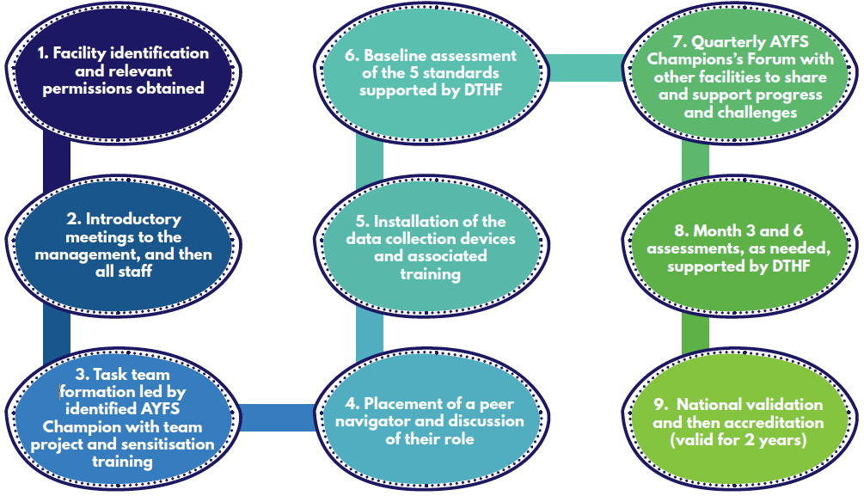
Pathway to AYFS accreditation

Slide 10
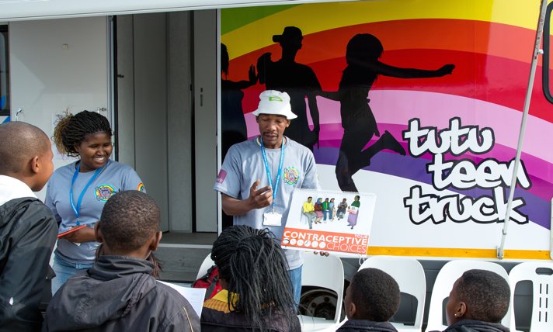
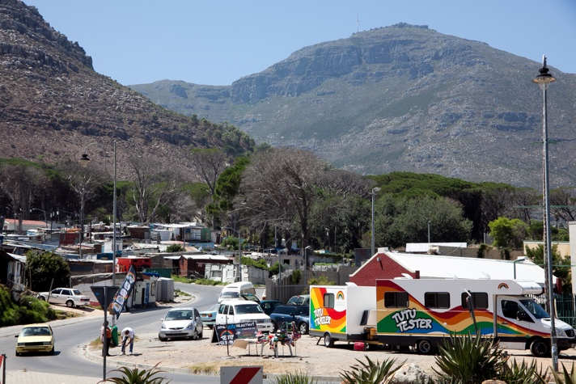
Tutu Teen Truck, Tutu Tester
HCT+
Rapid HIV testing & CD4 counts; incentives for linking to care
TB screening
STI test and treat
Pregnancy testing
Family planning counselling and contraception
Hypertension, diabetes mellitus, glucose, obesity screening
Oral PrEP
Risk reduction counselling
Trusted referral system to primary healthcare facilities
Follow-up calls to improve linkage to care
Incentives doubled # of new HIV diagnoses

Slide 11
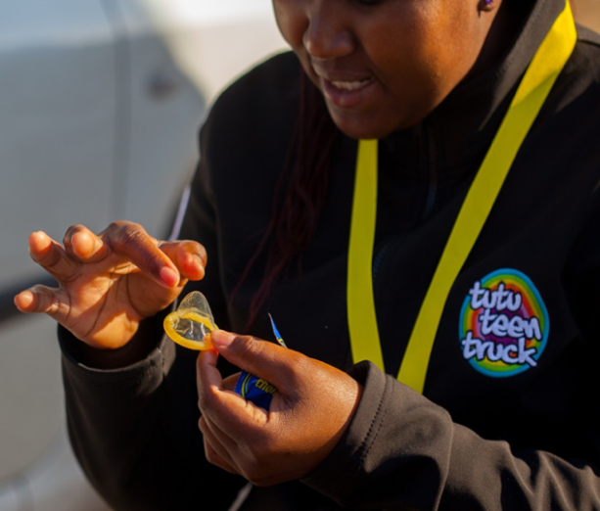
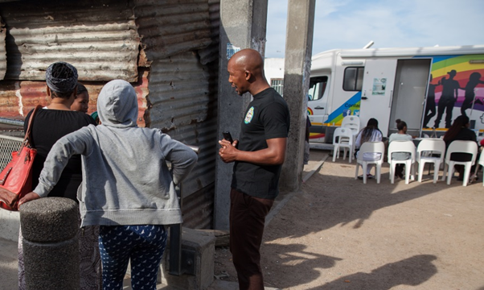
Mobile service appeal
Friendly, non-judgmental, accessible
Convenient spaces and times (12h00 – 18h00)
Sexy condoms & loud music
Social media, interactive information
Health education, quizzes and prizes
Biometric registration, tablet-based `. assessments
Peer support

Slide 12
Vital Voices: a Virtual Reality Film Series
Google, UNAIDS & OSF funding two VR films
First-person immersive stories about ART initiation and AYFS service provision
Focus on social empathy through viewing 360º VR stories of stigma experienced in healthcare settings
Aim: Shift negative perceptions about testing and treatment
Tool for intergenerational dialogue to address and combat stigma
Official launch World AIDS Day 2018
Aug-Sept 2018: Pre-testing survey research and facilitated screenings
VR content to be publicly installed long-term at clinic facilities

Slide 13
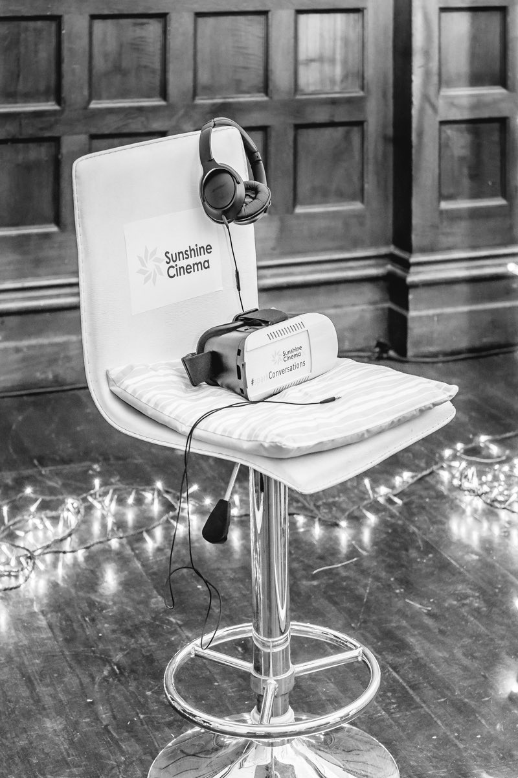
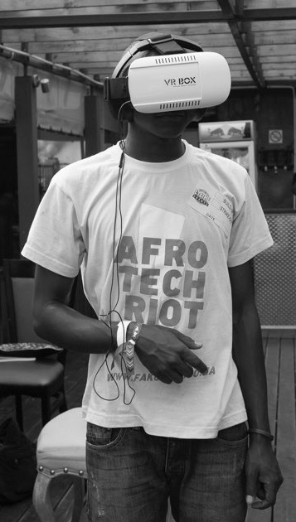
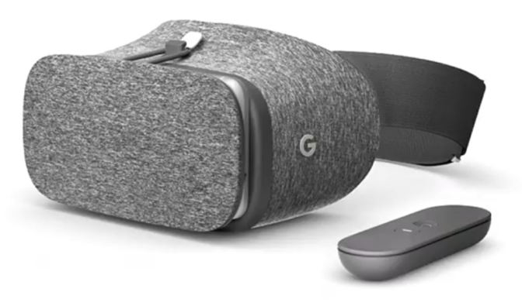
How would people experience this at a clinic?
1 x swivel chair
1 x mobile phone
1 x headphones
1 x Google headset
1x private space.
1x facilitator to monitor and feedback

Slide 14
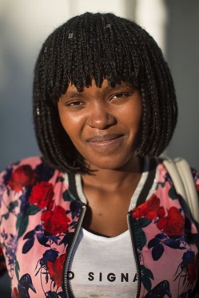
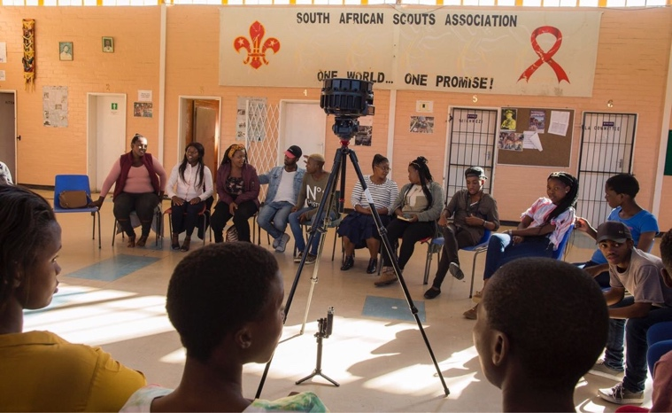
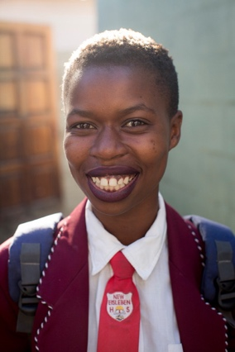
Youth storyboard pt 1
Building trust
Navigating a clinic visit
Female activist
see
see
We see a young person walking towards a clinic
We see and feel the eyes of a community looking at us as we walk into a facility. These could be your aunt or cousin. You dont want people to know you want to have an HIV test. This fear leads to many not getting tested. We will attempt to help a user navigate their way through the waiting room to help them feel more comfortable visiting a clinic.
say
We hear the voice of a young person who says: Hello, it was with great difficulty that I listened to the nurse tell me that the result of my HIV test is positive. Thinking back on the moment I don’t remember much. I just wanted to run out and get away. So many emotions came over me that I think I forgot to even listen to the nurse explain what I needed to do..
Front View
Young Client
see
The first sphere is chosen for the feeling of its location. When one is immersed in nature that feels safe, and unspoiled we relax. For that reason we open with a fast untouched coastline.
say
We hear a youthful voice guide us through in a very fun and matter of fact way. “Chillout, don’t stress, this is your life.
start
(Note: draft concept)
0m0sec
1m00sec
3m00sec

Slide 15
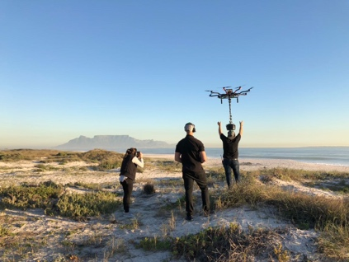
Youth storyboard pt 2
Your life at home with ARVS
Looking to a bright future
say
see
I learnt that the clinic staff do want me to live a healthy life and that they have good and bad days. I learnt to not give up until I find someone who understands me and is willing to be kind.
Spheres of triumph
say
When I got home I thought this is it I have found a way to live a long life. Anything is possible for me if I take my ARVs. I am not afraid of what others think
say
The voice concludes:
If there is one thing I have learnt from my journey living with HIV is that there is a bright future ahead. My clinic, my friends and my medication are very important to me. Without them in my life I would be in a very different place. Being HIV positive is not a death sentence if I stay on my treatment and keep going to my clinic. .
say
At the clinic I also learnt that their are friends to be made. People living with HIV are normal people that just carry a virus...Knowing I have someone my age to talk to has made me see how cool I am.
3-5min
4m00sec
5m00sec
end

Slide 16
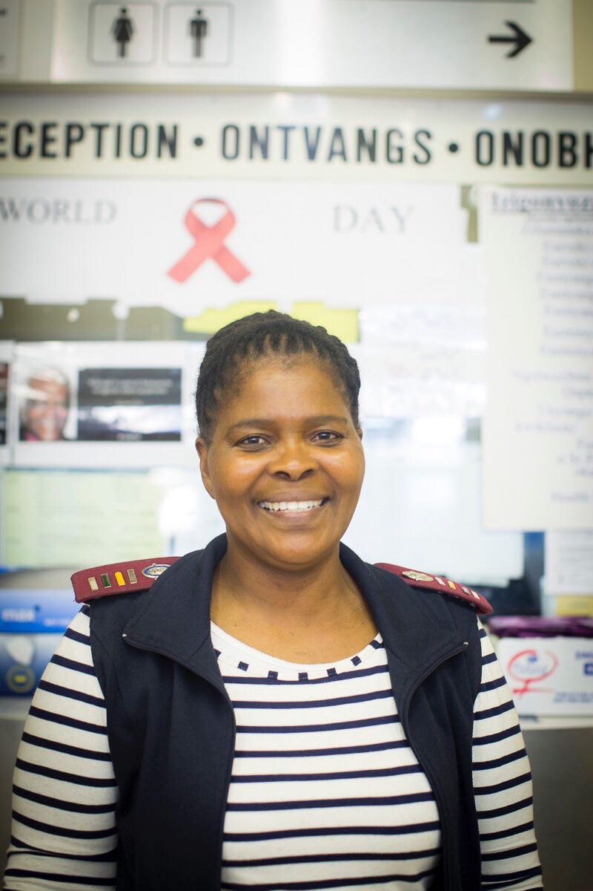
360 3D Film #2
Nurses: The effect of stigma

Slide 17
360 3D Film #2 Nurses: The effect of stigma
Pre-workshop script outline
Intro
Problem
Solution
We start in the homes of a few people who’s voices we here explaining who they are and what their concerns when it comes to being sexually active, getting tested for HIV and being treated by the nurses.
We see an individual in their home and them on the way to their clinic, as well as arrival at their clinic.
All characters arrive at the same clinic and thus our film plays out in one location from here on.
Once inside the clinic we see a sphere that allows us to understand some of the problems that are faced.
The audience experiences a sense of the judgement that is felt in the clinic space.
We then see a sphere of each of our characters being treated poorly by different nurses. 3 or more examples taken from actual testimonies.
Each negative example is followed by a consequence sphere. One patient throws their meds away after leaving, another runs out not taking their meds with them.
We could make use of a voice over that guides the viewer to now witness a better exchanges done by the same nurse to the same individuals. “Imagine if you as a nurse were not part of the problem?”
The voices of the youth come back strong now saying what they feel will be a better approach. We now see various examples of successful interactions. Leaving with Meds, breathing deeply and seeing some of the stress leave the patient, a hug, and a hand off to a peer to peer youth group.
Disclaimer: NOT the final film. Key focus on not criminalizing actions of nurses.
0m0sec
0m0sec
start
end
(Note: draft concept)

Slide 18
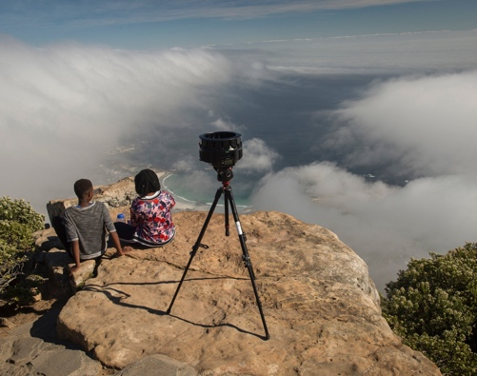
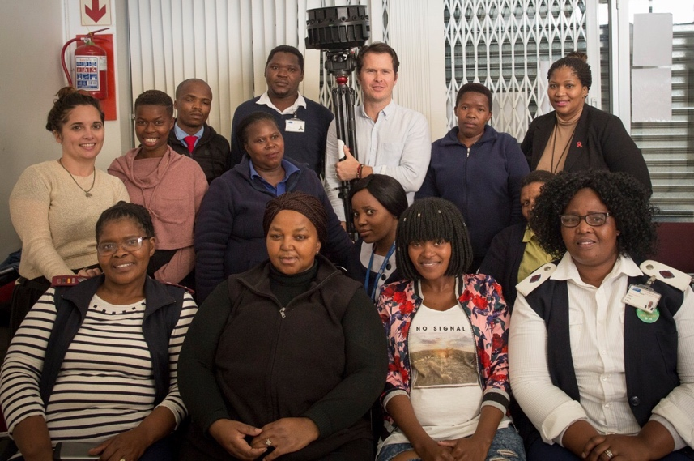
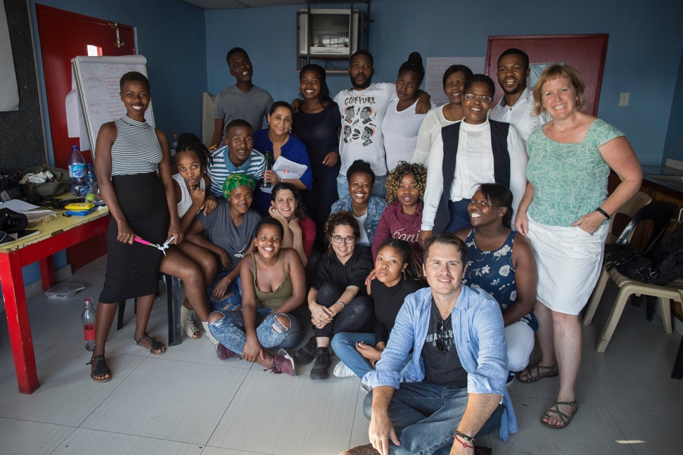
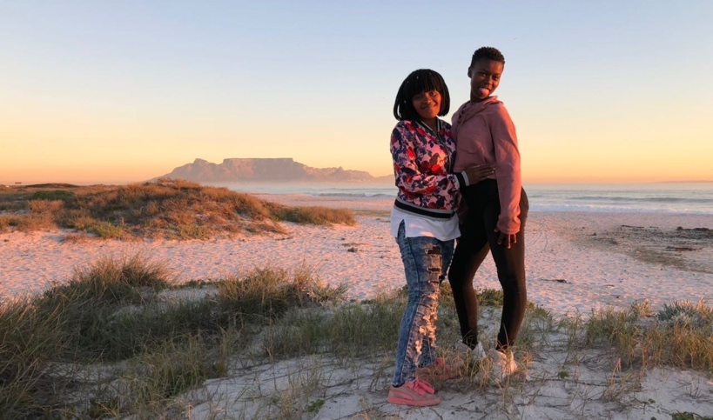
Pre-Production Workshop
Production

Slide 19
Conclusion
Adolescents want to engage with sexual health services, yet simultaneously avoid them
We need to listen to adolescents, remove barriers to access and tailor programmes to fit their needs
Trustworthy healthcare relationships are central to adolescent health-seeking behaviour
‘How can we stop nurses from shouting and harassing us and so we can prevent in peace?’

Slide 20
Acknowledgements
Linda-Gail Bekker, Philip Smith, Elzette Rousseau, Nadia Ahmed, Katherine Gill (DTHF)
Sydelle Willow Smith & Rowan Pybus
Our passionate and innovative staff dedicated to adolescent health:

